Slide 1

Online Grocery Shopping System
Submitted By :
Riya Chhillar
Himanshu Kumar
Sumit Mukherjee
Subhadip Chakraborty
Srijani Chatterjee

Slide 2
OVERVIEW
Introduction
Requirements
Feasibility Study
Screenshots
Applications of the Project
Future Scope and References
Conclusion

Slide 3
Introduction
The parameters of online shopping have expanded to groceries over the last five years. And the response people have shown gives Indian ecommerce yet another victory. The fact that grocery goods do not always need to be tried or felt before buying makes this category of online business so amazing. The biggest advantage is people do not need to exit their homes to buy groceries with online shopping services.
Objective:
The main objective of proposed system, is used to provide Online Grocery Shopping solution to consumers by getting rid of the tedious task of commuting to the local store for buying groceries.
The whole idea is to ease the lives of people.
Users can sit back in their homes or offices and order the required products and it will be delivered to their doorstep in the required time. All that needs to be done, is the account creation and then the user is ready to go.
The users security is our primary concern. No unauthorized user can have access.

Slide 4
Software Requirements
OS: Windows 10
Database: Oracle
IDE: Spring Tools Suite, Spring Boot
Server: Tomcat
Front End: HTML, CSS, JavaScript
Back End: Java

Slide 5
Feasibility Study
Technical Feasibility:
This assessment focuses on the technical resources available to the organization The project is technically feasible since the technical resources meet capacity and the technical team is capable of converting the ideas into working systems
Financial Feasibility:
The project is financially feasible as it is a low cost method. The cost of establishment as well as the expense of the users is less compared to the market.
Operational Feasibility: On undertaking a study to analyze and determine whether—and how well—the organization’s needs can be met by completing the project, it was concluded that the project is operationally feasible.
The project plan satisfies all the requirements.

Slide 6
SCREENSHOTS

Slide 7
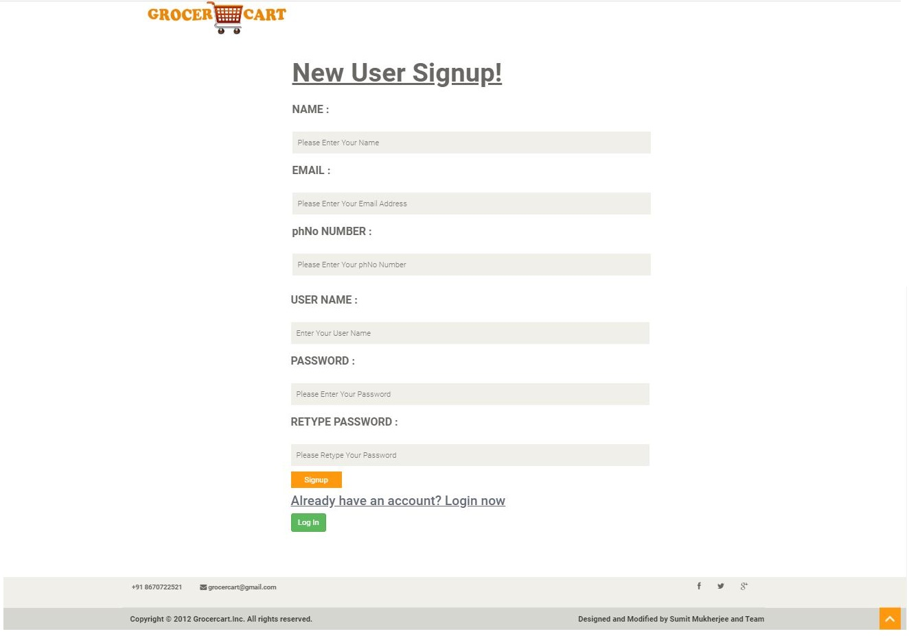

Slide 8
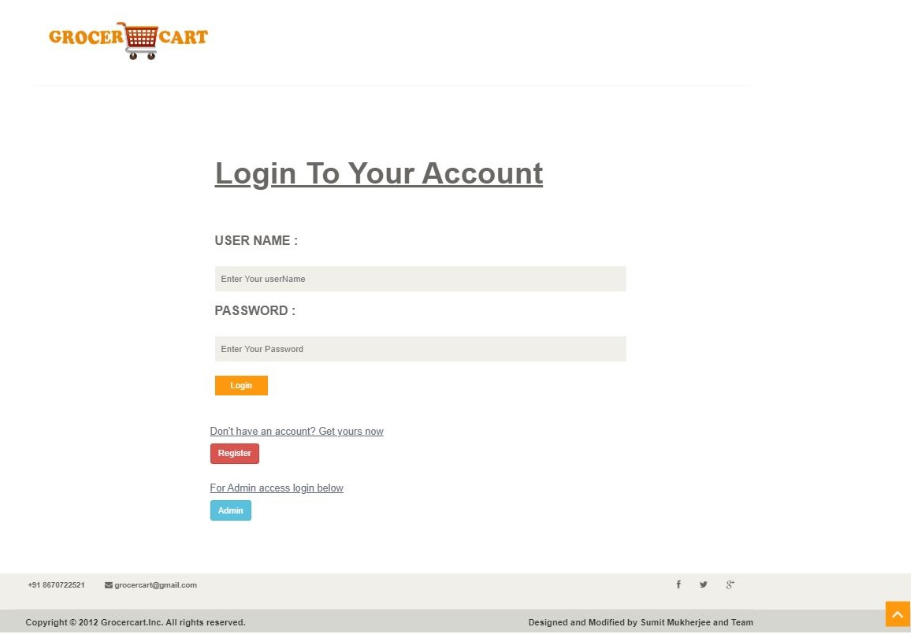

Slide 9
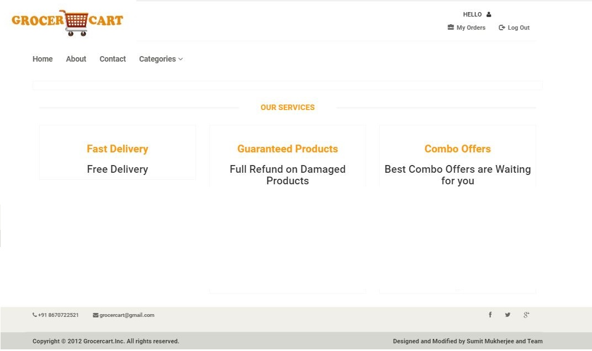

Slide 10
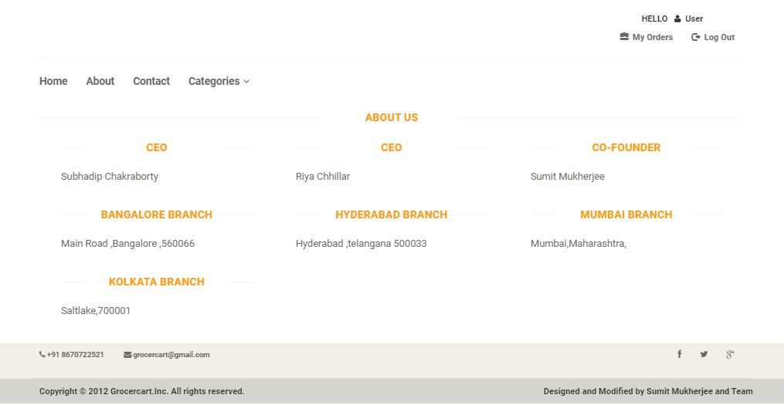

Slide 11
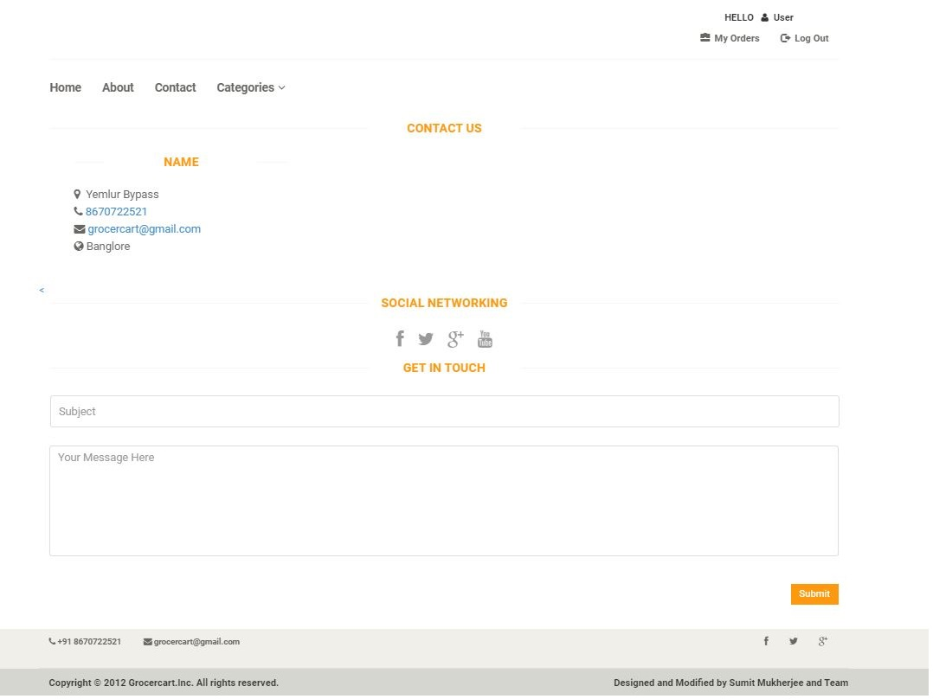

Slide 12
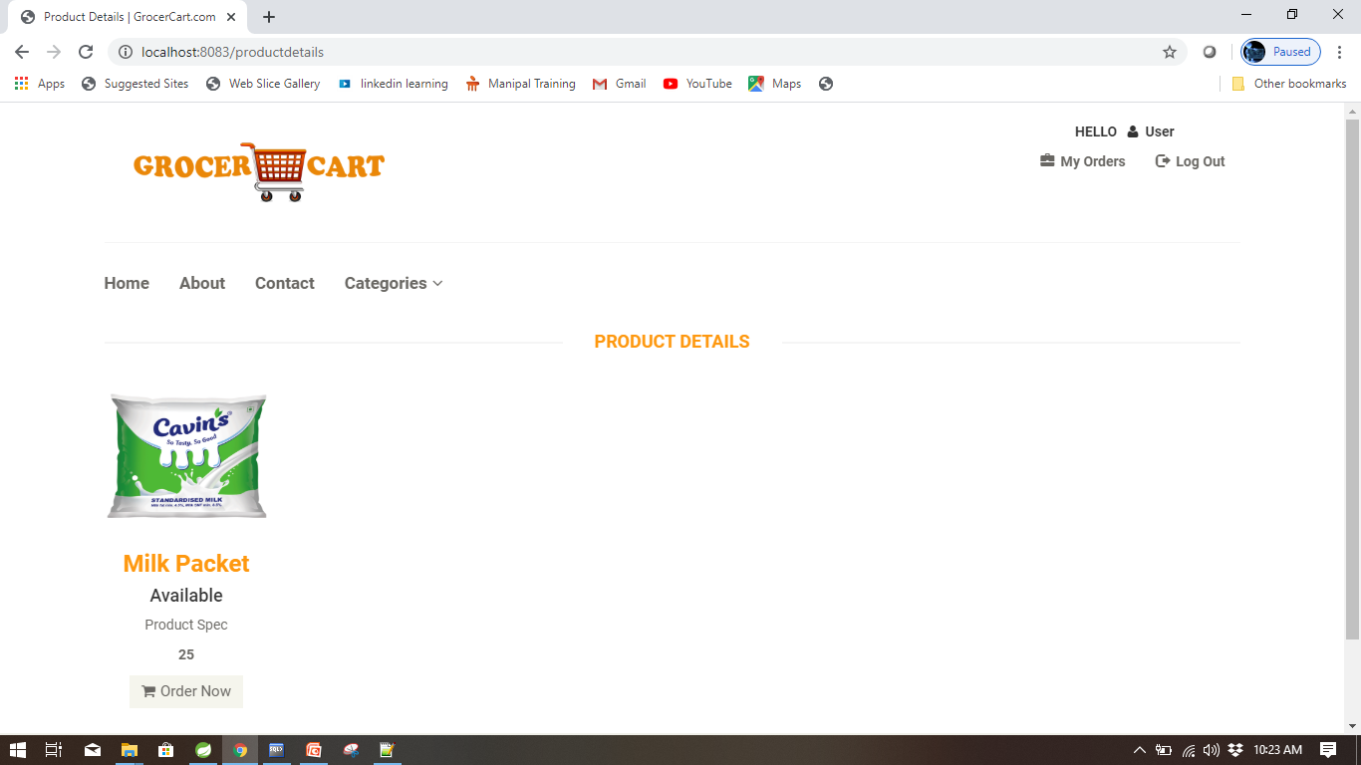

Slide 13
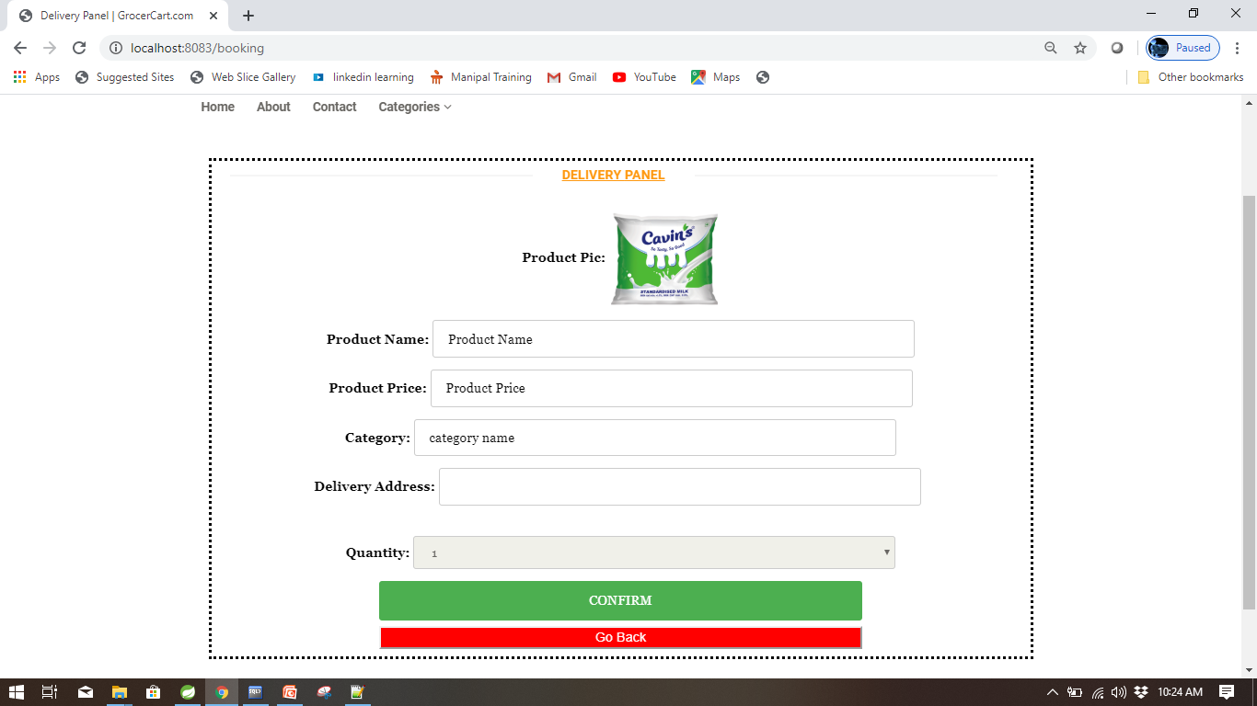

Slide 14
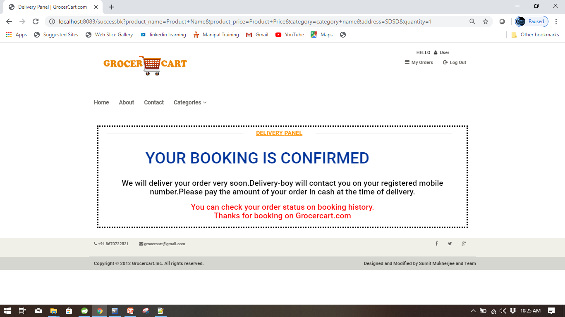

Slide 15
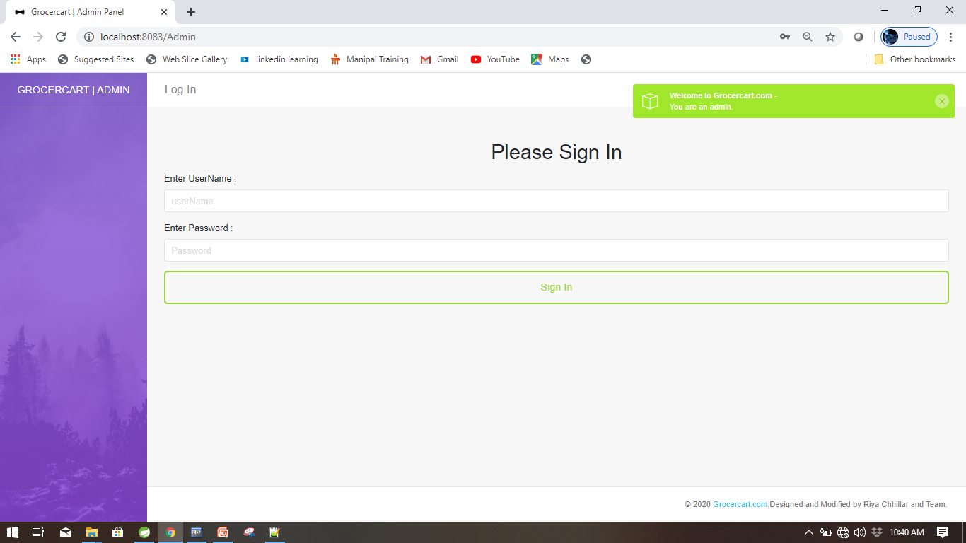

Slide 16
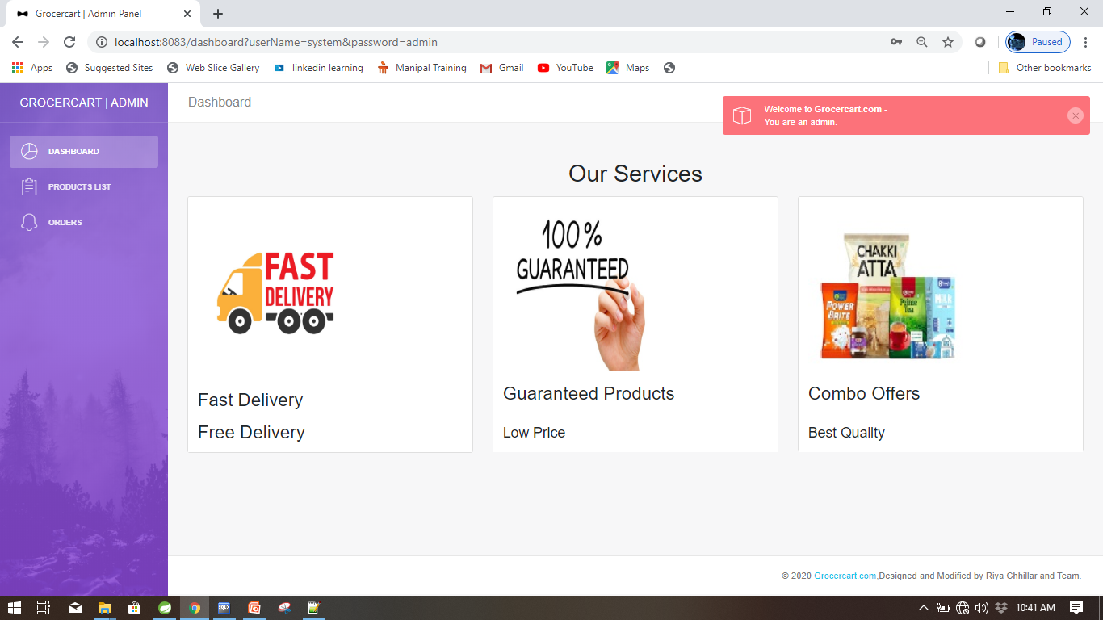

Slide 17
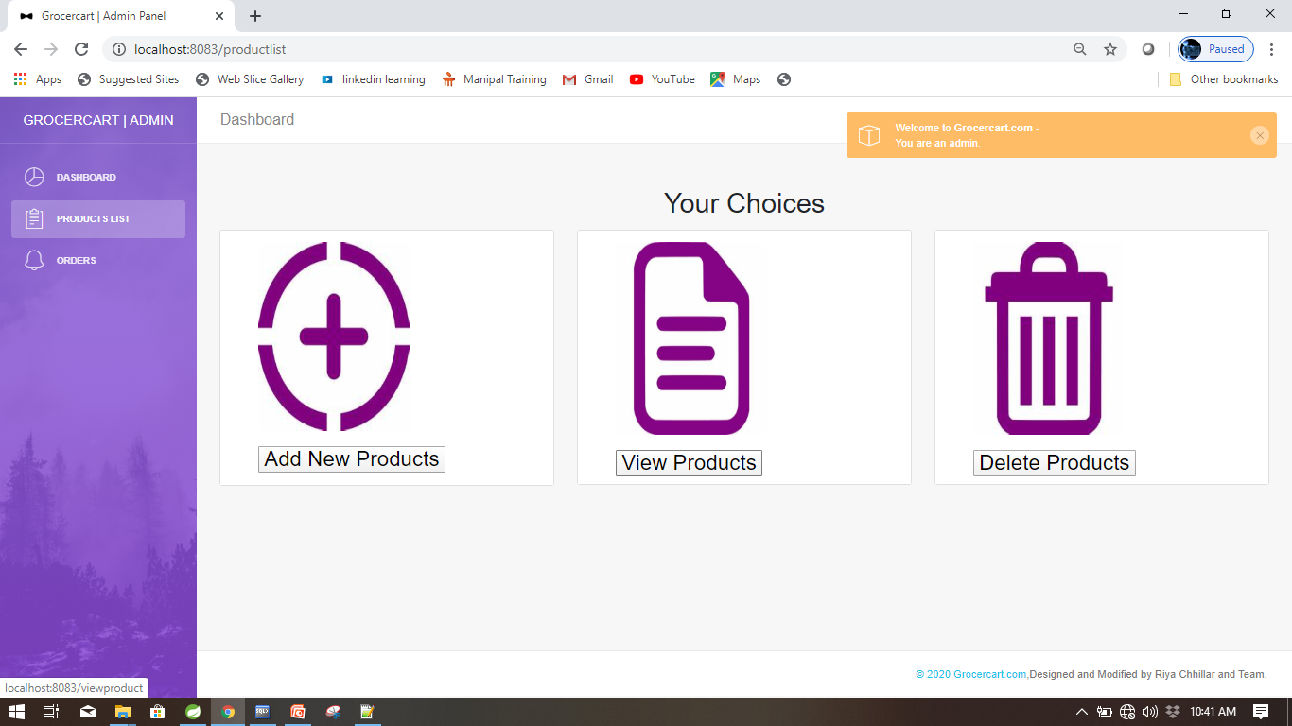

Slide 18
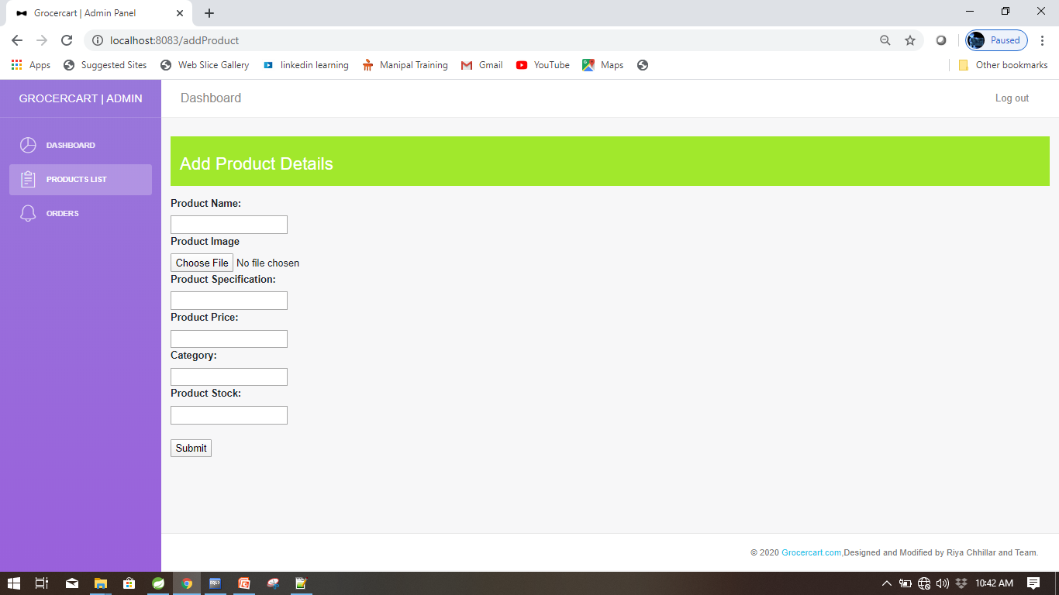

Slide 19
Application of The Project
Convenient: Online Grocery Shopping is convenient. People do not have to leave their homes to visit stores for Grocery Shopping. They can login, look for good products and then proceed to buy and order for their products.
Range of choices: It offers a great variety of options they usually have a large stock of products than a physical store. Therefore, whatever products the user needs can be easily found here. If a product is unavailable the user can choose to be notified as soon as the product is available.
Timesaving: We can save a lot of time and money by using Online Grocery Shopping System. People who live far from retail outlets and those with busy schedules can find this advantageous. They can buy multiple products at a minimum time.
Affordable: There are no middle men present between the customer and manufacturer. Customers buy products directly from the manufacturers. So, their products are considerably cheaper than those in local stores.

Slide 20
Future Scope
Despite the nation’s grocery market size and its online potential, only 1% of groceries are bought online. It tells us e-grocery stores have not attained their potential. We are just in the initial stage waiting for a push that leads to success.
Marketers are often interested in attracting not just brand users, but perhaps more importantly, those who consistently purchase the company’s brand. In the context of retailing, this means identifying and attracting regular visitors and buyers at a retail store.
Another scope is : One Stop Shopping, which focuses on the availability of different popular brands, good quality store and availability of several products under one roof ensures that the modern consumer can shop at the same store and not move around several stores to buy merchandise.

Slide 21
Conclusion
Online Delivery is the best way to purchase any item but be careful because there may be some fake products on different websites.
Be careful while choosing your products. Read the customer reviews and check the product ratings before purchasing something.
We do have a genuine website. We strictly do not sell spiked or duplicate products. We assure good quality products. Customer satisfaction is our main motive.
GrocerCart.com
Spend For Quality

Slide 22
THANK YOU

